Slide 1

Object & Pedestrian Detection
赵海伟 戴嘉伦 王如晨
CVBIOUC, Ocean University of China
指导教师：郑海永

Slide 2
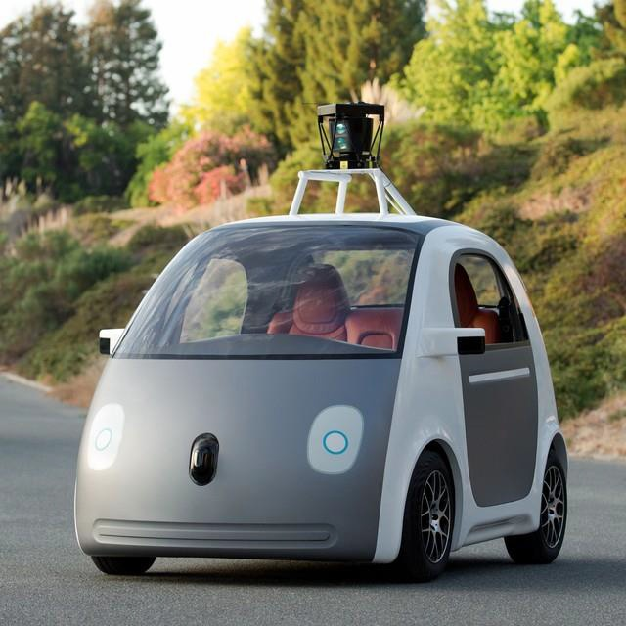
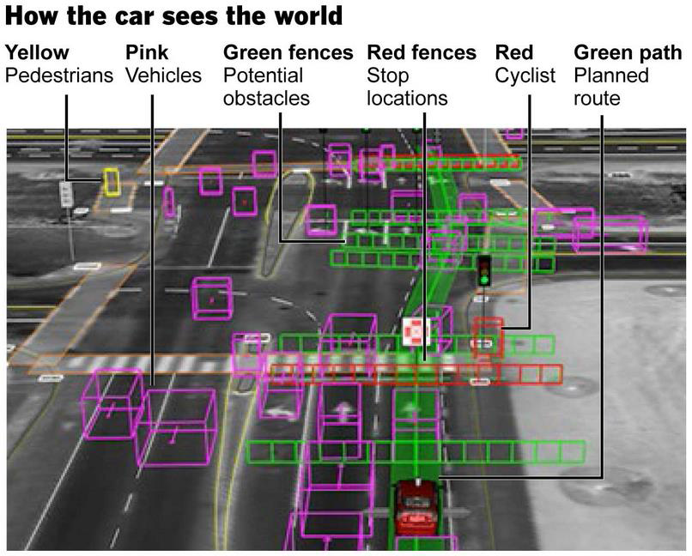
Driverless car
Google’s driverless car
Sebastian Thrun
(Google & Stanford)

Slide 3
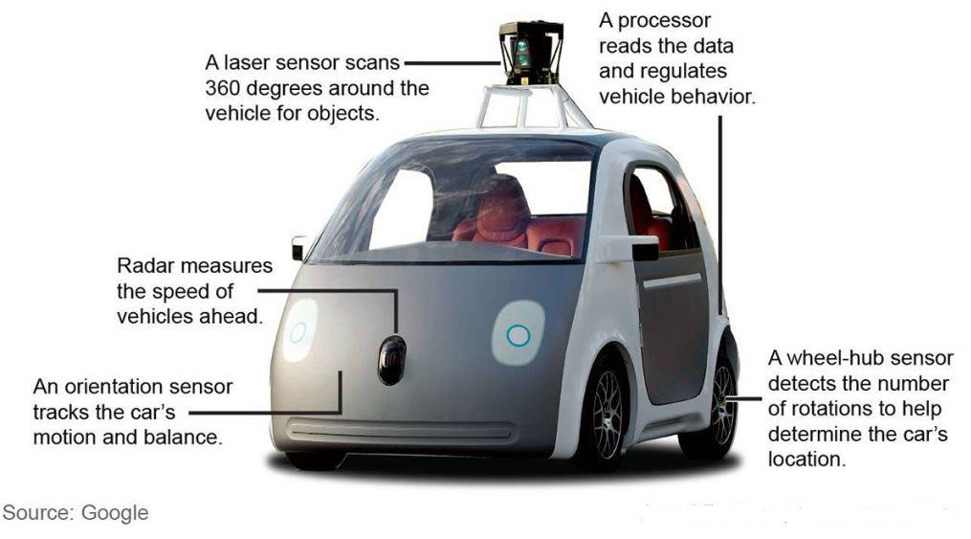
Driverless car
Sensors

Slide 4
Computer Vision
Computer Vision
Input
Pre-proccessing
Detection
Segmentation
Detection
Objectness
Matching
Saliency
Recognition
3D Modeling
Output

Slide 5
Object Detection&Pedestrian
Object detection：
Introduction
Pedestrian Detection
Feature
Classifier
Deep Learning
The limitations and failures of object detection
Related works：
Fixation prediction/Salient object detection/Image
segmentation/Image matching/Objectness proposal generation
methods

Slide 6
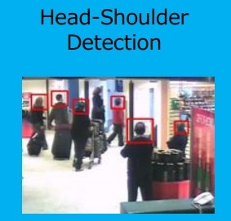
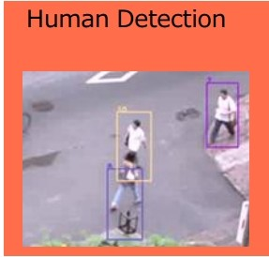
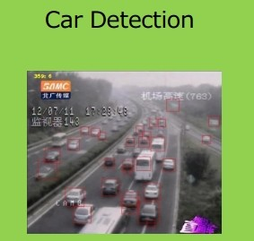
Object detection
Object detection
How to answer the question : What is where?
Some of them have come into our lives.

Slide 7
Object detection
Google’s driverless car
Sebastian Thrun
(Google & Stanford)

Slide 8
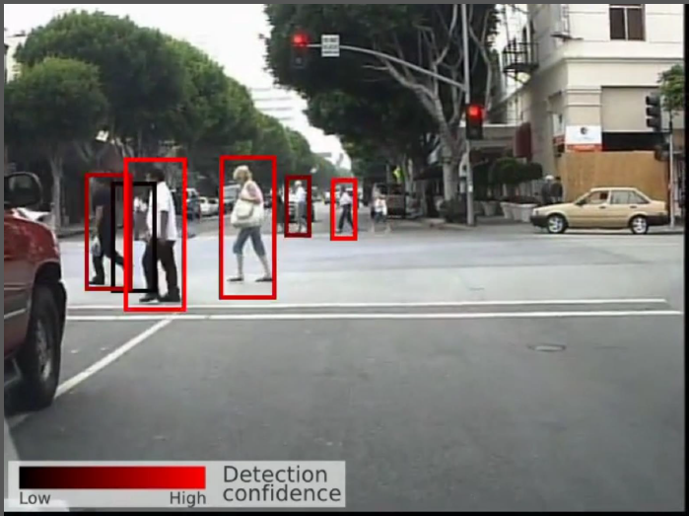

Object detection
Pedestrian Detection
Filtered Channel Features for Pedestrian Detection.CVPR 2015 , Shanshan Zhang et al.

Slide 9
Pedestrian Detection(HOG)
Histogram of Oriented Gradients for Human Detection
An overview of the feature extraction and object detection chain:
Histograms of Oriented Gradients for Human Detection .CVPR 2005 , Dalal et al.
Notes:
在一幅图像中，局部目标的外观和形状能够被梯度或者边缘的方向密度分布很好的描述。（也就是说梯度主要存在于边缘的地方）

Slide 10
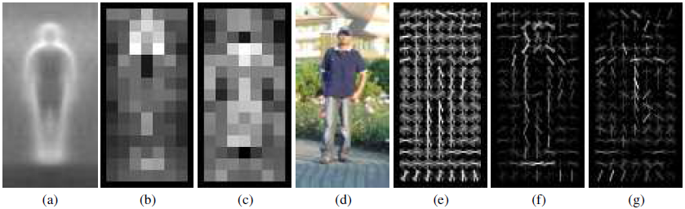
Pedestrian Detection(HOG)
Histograms of Oriented Gradients for Human Detection
(a) The average gradient image over the training examples.
(b) Each pixel shows the maximum positive SVM weight in the block centred on the pixel.
(c) Likewise for the negative SVM weights.
(d) A test image.
(e) It's computed R-HOG descriptor.
(f,g) The R-HOG descriptor weighted by respectively the positive and the negative SVM weights.
Histograms of Oriented Gradients for Human Detection .CVPR 2005 , Dalal et al.

Slide 11
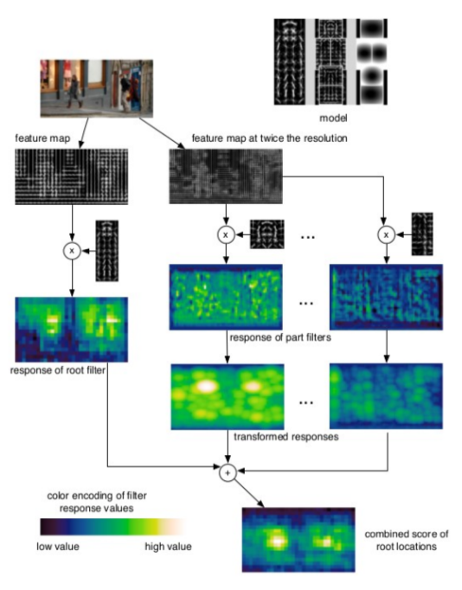
Pedestrian Detection(DPM)
Deformable Parts Model:
HOG Feature
Part Model
Latent SVM
Object detection with discriminatively trained partbased models. PAMI 2010, Ross et al.
Notes:
先计算HOG（方向梯度直方图）特征，然后用SVM训练得到物体的梯度模型。模型就可以直接用来分类（模型和目标匹配）。金字塔：不同分辨率上提取HOG特征。最右边图：偏移cost。

Slide 12
Pedestrian Detection
Sliding Window
BING: Binarized Normed Gradients for Objectness Estimation at 300fps, CVPR 2014, Ming-Ming Cheng et al.
Notes:
获得窗口位置策略:滑动窗口：训练好的模板在输入图像的多个尺度上进行滑动扫描，确定最大响应位置，找到目标物体的外接窗口。

Slide 13
Object detection
Training
Objects
feature
extraction&selection
Training
images
feature
extraction&selection
training
Non-objects
HOG
LBP
...
Boosting
Deep Learning
…
Input image
pre-processing
feature
extraction&selection
classifier
Proposals
Detection
Notes:
传统的目标检测：用训练样本中标记好的含有目标的窗口进行分类器训练，每类物体都要训练一个特定的分类器，测试时用窗口遍历测试样本进行分类从而检测出物体的位置以及类别。

Slide 14
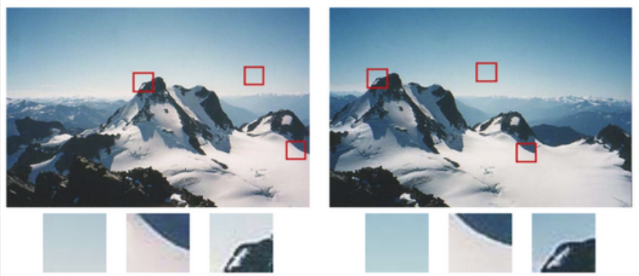
Feature
Feature
In feature space we can distinguish object and non-object.
Point feature (Demo)
Harris, FAST, etc.
Local feature
HOG, LBP, et al
Global feature (Demo)
Color Histogram, et al

Slide 15
Feature
Feature
Detector
Extractor
Descriptor
Feature Detection (Demo)
Feature Extraction
兴趣点检测
密集提取
Feature Description
Detect the feature
Extract the feature
Descript the feature
feature
extraction&selection
图像物体分类与检测算法综述。计算机学报 2013 , 黄凯奇 et al.
Notes:
特征提取：特征点检测算法通过某种准则选择具有明确定义的、局部纹理特征比较明显的像素点、边缘、角点、区块，并且通常能够获得一定的集合不变性。从图像中按固定的步长、尺度提取出大量的局部特征描述、大量的局部描述尽管具有更高的冗余度，但信息更加丰富。
兴趣点检测算法通过某种准则选择具有明确定义的、局部纹理特征比较明显的像素点、边缘、角点、区块等，并且通常能够获得一定的几何不变性，从而可以在较小的开销下得到更有意义的表达。
近年来物体分类领域使用更多的则是密集提取的方式，从图像中按固定的步长、尺度提取出大量的局部特征描述，大量的局部描述尽管具有更高的冗余度，但信息更加丰富，后面再使用词包模型进行有效表达后通常可以得到比兴趣点检测更好的性能。

Slide 16
Feature
Feature
Descriptor
Feature Description
向量化编码
核词典编码
稀疏表示
局部线性约束编码
显著性编码
Fisher向量编码
超向量编码
Detector
Detect the feature
Extractor
Extract the feature
Descript the feature
feature
extraction&selection
Notes:
特征编码：提取的底层特征中包含了大量的冗余和噪声，为提高特征表达的鲁棒性，需要使用一种特征变换算法对底层特征进行编码，从而获得更具区分性、更加鲁棒的特征表达，这一步对物体识别的性能具有至关重要的作用。

Slide 17
Feature(HOG)
Histograms of Oriented Gradients for Human Detection
(a) The average gradient image over the training examples.
(b) Each pixel shows the maximum positive SVM weight in the block centred on the pixel.
(c) Likewise for the negative SVM weights.
(d) A test image.
(e) It's computed R-HOG descriptor.
(f,g) The R-HOG descriptor weighted by respectively the positive and the negative SVM weights.
Histograms of Oriented Gradients for Human Detection .CVPR 2005 , Dalal et al.

Slide 18
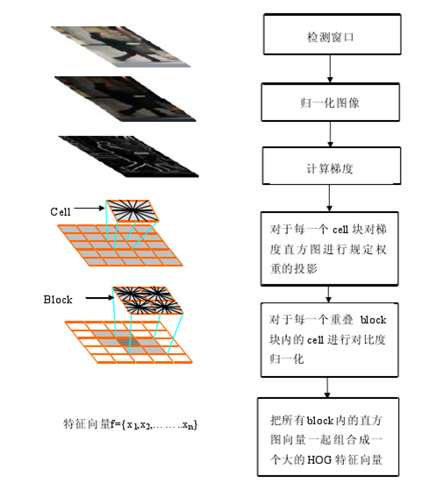
Feature(HOG)
HOG(Histogram of Gradient)
Histograms of Oriented Gradients for Human Detection .CVPR 2005 , Dalal et al.
Notes:
在一幅图像中，局部目标的外观和形状能够被梯度或者边缘的方向密度分布很好的描述。（也就是说梯度主要存在于边缘的地方）

Slide 19
Object detection
Train a classifier to classify proposals which contain objects ：
Feature is extracted and described as descriptor by detector and Extractor
Train a classifier to classify proposals which contain object
Training
Objects
Objects
Training
images
feature
extraction&selection
feature
extraction&selection
training
Non-objects
Non-objects
HOG
LBP
...
Boosting
Deep Learning
…
Input image
pre-processing
feature
extraction&selection
classifier
Proposals
Notes:
从图像提取到特征表达之后，一张图像可以使用一个固定维度的向量进行描述，接下来就是学习一个分类器对图像进行分类。
常用的分类器有支持向量机、K近邻、神经网络、随机森林等。其中SVM、AdaBoost是Deep Learning之前最常用的分类器。

Slide 20
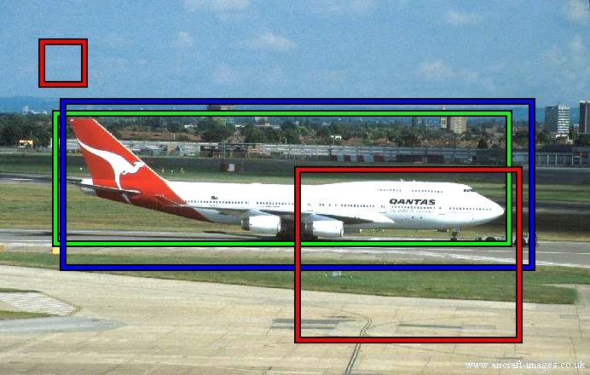
Object&Non-object
Examples
The annotated object window : green
Positive examples: blue
Negative examples: red
What is an object ?, CVPR 2010 , Alexe et al.

Slide 21
Object detection
Training
Objects
Objects
feature
extraction&selection
Training
images
feature
extraction&selection
training
Non-objects
Non-objects
HOG
LBP
...
Boosting
Deep Learning
…
pre-processing
classifier
Input image
feature
extraction&selection
classifier
Proposals
Detection

Slide 22
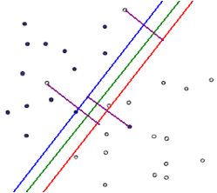
Classifier(SVM)
SVM(Support Vector Machine)(Demo)
A training algorithm for optimal margin classifiers. 1992, Vapnik, et al.
Notes:
模型就是线性超平面。

Slide 23
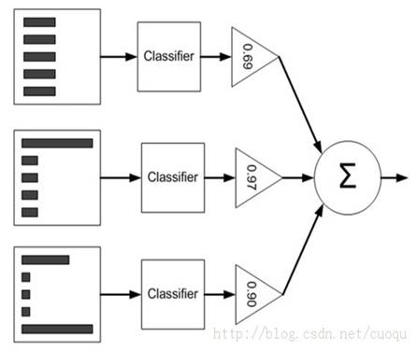
Classifier(Adaboost)
Adaboost
A Decision-Theoretic Generalization of on-Line Learning and an Application to Boosting.1995， Freund et al.
Notes:
Adaboost是一种迭代算法，其核心思想是针对同一个训练集训练不同的分类器（弱分类器），然后把这些弱分类器集合起来，构成一个更强的最终分类器（强分类器）。其算法本身是通过改变数据分布来实现的，它根据每次训练集之中每个样本的分类是否正确，以及上次的总体分类的准确率，来确定每个样本的权值。将修改过权值的新数据集送给下层分类器进行训练，最后将每次训练得到的分类器最后融合起来，作为最后的决策分类器。

Slide 24
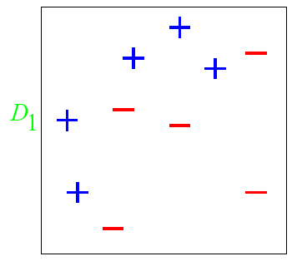
Classifier(Adaboost)
Adaboost
A Decision-Theoretic Generalization of on-Line Learning and an Application to Boosting.1995， Freund et al.

Slide 25
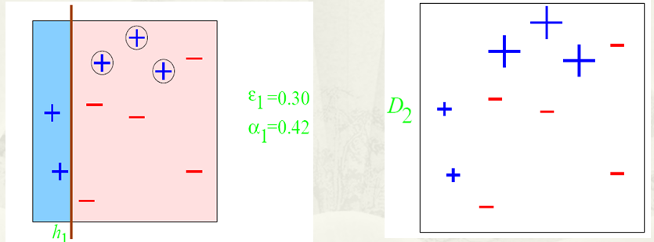
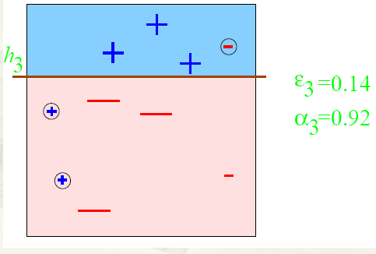
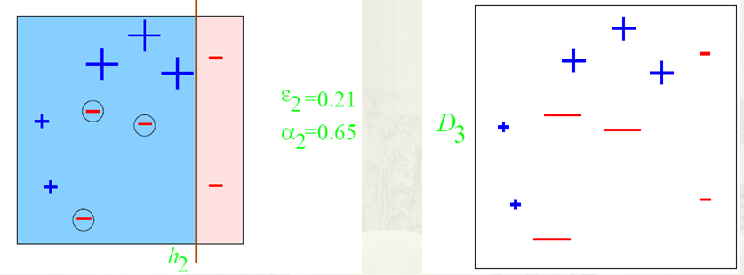
Classifier(Adaboost)
Adaboost
A Decision-Theoretic Generalization of on-Line Learning and an Application to Boosting.1995， Freund et al.

Slide 26
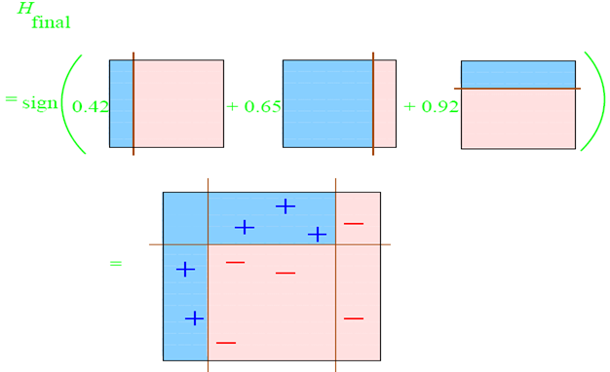
Classifier(Adaboost)
Adaboost
A Decision-Theoretic Generalization of on-Line Learning and an Application to Boosting.1995， Freund et al.

Slide 27
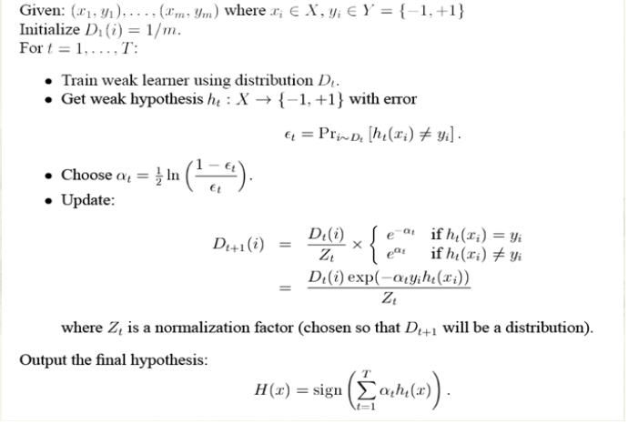
Classifier(Adaboost)
Adaboost
A Decision-Theoretic Generalization of on-Line Learning and an Application to Boosting.1995， Freund et al.

Slide 28
Classifier(Adaboost)
Adaboost
A Decision-Theoretic Generalization of on-Line Learning and an Application to Boosting.1995， Freund et al.

Slide 29
Classifier(Adaboost)
Adaboost(Demo)
A Decision-Theoretic Generalization of on-Line Learning and an Application to Boosting.1995， Freund et al.

Slide 30
Object detection
Training
Objects
Training
images
feature
extraction&selection
training
Non-objects
HOG
LBP
...
Boosting
Deep Learning
…
Input image
pre-processing
feature
extraction&selection
classifier
Proposals
Detection

Slide 31
Pedestrian Detection(HOG)
Histogram of Oriented Gradients for Human Detection
An overview of the feature extraction and object detection chain:
Histograms of Oriented Gradients for Human Detection .CVPR 2005 , Dalal et al.
Notes:
在一幅图像中，局部目标的外观和形状能够被梯度或者边缘的方向密度分布很好的描述。（也就是说梯度主要存在于边缘的地方）

Slide 32
Pedestrian Detection(DPM)(Demo)
Deformable Parts Model:
HOG Feature
Part Model
Latent SVM
Object detection with discriminatively trained partbased models. PAMI 2010, Ross et al.
Notes:
先计算HOG（方向梯度直方图）特征，然后用SVM训练得到物体的梯度模型。模型就可以直接用来分类（模型和目标匹配）。金字塔：不同分辨率上提取HOG特征。最右边图：偏移cost。

Slide 33
Object detection
PCA
Negativeexample
Training
Objects
Training
images
feature
extraction&selection
training
Non-objects
HOG
LBP
...
Boosting
Deep Learning
…
Non-Maximum Suppression
Input image
pre-processing
feature
extraction&selection
classifier
Proposals
Detection
Deep Learning

Slide 34
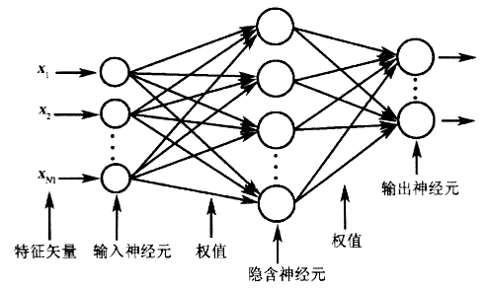
Deep Learning
The Neural Network
A logical calculus of the ideas immanent in nervous activity. 1943, W.S.McCulloch, et al.
Notes:
神经网络是由大量的、简单的处理单元（称为神经元）广泛地互相连接而形成的复杂网络系统，它反映了人脑功能的许多基本特征，是一个高度复杂的非线性动力学习系统。

Slide 35
Deep Learning
Deep Learning(Demo)
Learning hierarchical feature expression.
Descriping the object from the bottom to the top.
Information Processing in Dynamical Systems. MIT 1986, Paul et al.
Auto-association by multilayer perceptions and singular value decomposition. 1988, H Bourlard et al.
Gradient-based learning applied to document recognition, IEEE 1998.Y. LeCun et al.
A fast learning algorithm for deep belief nets. Neural Computation .2006, Hinton et al.
Enhanced biologically inspired model for object recognition, IEEE 2011, Huang Yongzhen et al.
Notes:
深度学习的动机在于建立、模拟人脑进行分析学习的神经网络，它模仿人脑的机制来解释数据。
深度学习的概念源于人工神经网络的研究，通过组合低层特征形成更加抽象的高层表示属性类别或特征，以发现数据的分布式特征表示。
主流的深度学习模型包括自动编码器、受限波尔兹曼机、深度信念网络、卷积神经网络、生物启发式模型。

Slide 36
Object detection
The limitations and failures of Object detection ：
Only solving the problem of a certain kind of target detection
Detection accuracy is low
The size of training dat set is difficult to determine
Detection time is long
It is necessary to develop more powerful methods
Notes:
由于测试时需要遍历窗口因此非常消耗计算资源，这样对于一个实时的行人监测系统来说，我们只好选择弱特征（为快速计算，如HOG），以及弱的分类器（也是为了快速计算，如SVM）。

Slide 37
Object detection
Computer Vision
Input
Pre-proccessing
Detection
Segmentation
Objectness
Matching
Saliency
Recognition
Detection
Matching
3D Modeling
Recognition
Segmentation
Output

Slide 38
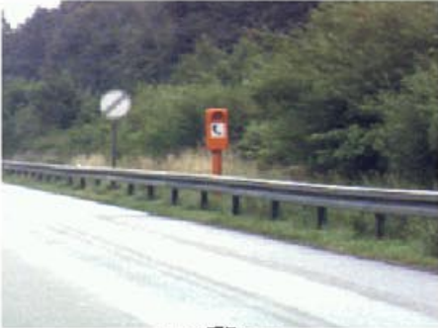
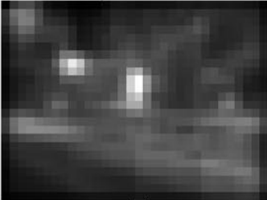
Related works
Fixation prediction
Predicting saliency points of human eye movement
A model of saliency-based visual attention for rapid scene analysis. PAMI 1998, Itti et al.
Saliency detection: A spectral residual approach. CVPR 2007, Hou et al.
Graph-based visual saliency. NIPS, Harel et al.
Quantitative analysis of human-model agreement in visual saliency modeling: A comparative study, IEEE TIP 2012, Borji et al.
A benchmark of computational models of saliency to predict human fixations, TR 2012.

Slide 39

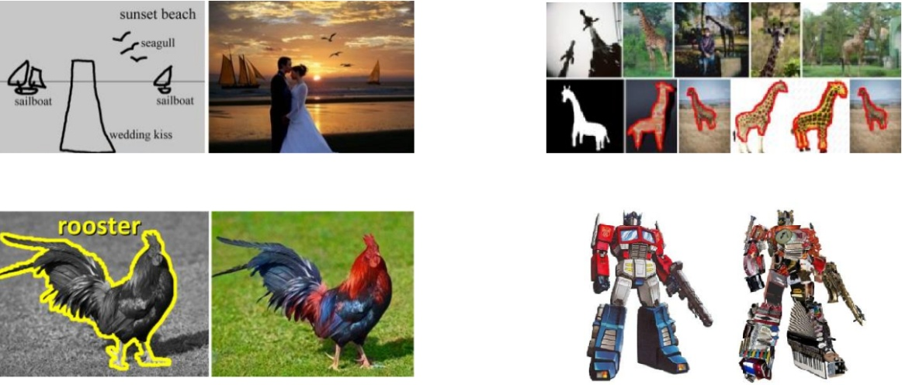
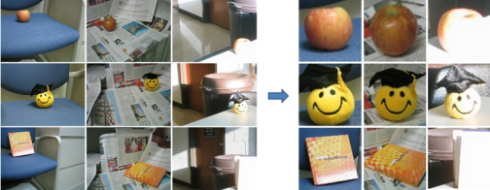
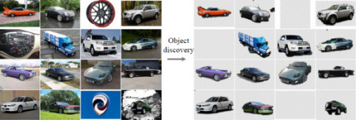
Related works
Salient object detection
Detect the most attention-grabbing object in the scene
Applications
Learning to detect a salient object. CVPR 2007, Liu et al.
Frequency-tuned salient region detection, CVPR 2009, Achanta et al.
Global contrast based salient region detection, CVPR 2011, Cheng et al.
Salient object detection: a benchmark, Ali et al.
[ACM TOG 09, Chen et al.] [Vis. Comp. 13, Cheng et al.] [CVPR 12, Zhu et al.]
[ACM TOG 11, Chia et al.] [ACM TOG 11, Zhang et al.] [CVPR 13, Rubinstein et al.]

Slide 40
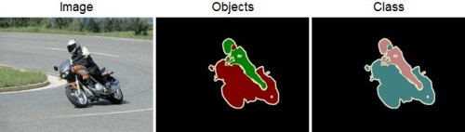
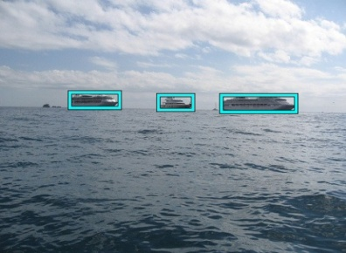
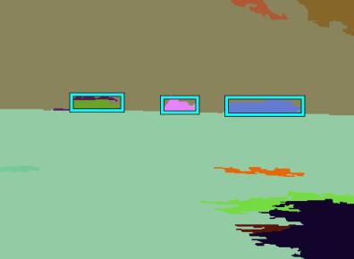
Related works
Image segmentation(Demo)
Each solid color corresponds to a distinct annotated object.
All other pixels are considered background.
Superpixel segmentation
Learning a classification model for segmentation.IEEE 2003, Ren et al.
Efficient graph-based image segmentation .2004 Felzenswal et al.
Normalized cuts and image segmentation .IEEE 1997,SHI J et al.
Entropy rate superpixel segmentation.CVPR 2011,Liu M Y et al.
Notes:
以往基于像素级的图像处理，也不能给出目标区域的边界，只能给出一个大概的位置。这是因为，像素并不是人类视觉的着重点。因为，人类获得图像是从许多的像素点的组合的一个区域而来的，单一的某个像素点并不具有什么实际意义，只有组合在一起对人类而言才有意义。
超像素，即在图像中由一系列位置相邻且颜色、亮度、纹理等特征相似的像素点组成的小区域，这些小区域大多保留了进一步进行图像分割的有效信息，且一般不会破坏图像中物体的边界信息。

Slide 41
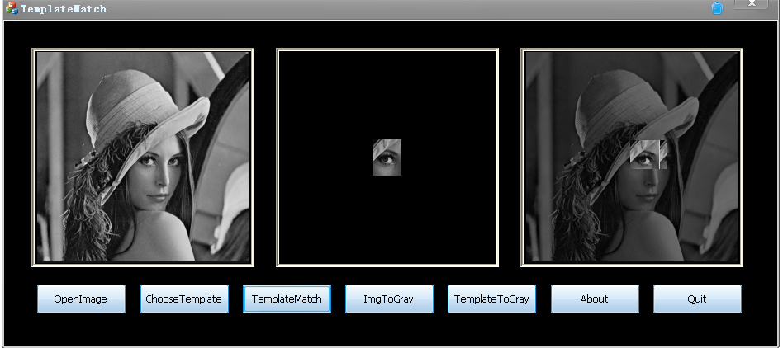
Related works
Image matching(Demo)
Based on image content, features, structure, relation,et al
Analysis the similarity and consistency
Seeking similar image target
Comparing images using the Hausdorff distance under translation.CVPR 1992, Huttenlocher et al.
Comparing Images Using the Hausdorff Distance.PAMI 1993, Daniel, et al.
A modified Hausdorff distance for object matching.ICPR 1994, Jain, et al.
Object matching algorithm using robust Hausdorff distance measure.1999 Sim,et al.
Notes:
提取特征，相似性度量。
欧式距离、马氏距离、Hausdorff等。

Slide 42
Related works
Proposal generation algorithm [CVPR 11, Zhang et al.]
Scale/aspect-ratio quantization
Two-stage cascaded ranking SVMs
Learning a linear classifier for each quantized scale/aspect-ratio
Learning another global linear classifier for calibration
Other efficient search mechanism
Branch-and-bound
Approximate kernels
Efficient classifiers
…
Proposal Generation for Object Detection using Cascaded Ranking SVMs. CVPR 2011, Zhang et al.
Beyond sliding windows: Object localization by efficient subwindow search. CVPR 2008, Lampert et al.
Classification using intersection kernel support vector machines is efficient. CVPR 2008, Maji et al.
Efficient additive kernels via explicit feature maps. TPAMI 2012, A. Vedaldi and A. Zisserman.
Histograms of oriented gradients for human detection. CVPR 2005, N. Dalal and B. Triggs.

Slide 43
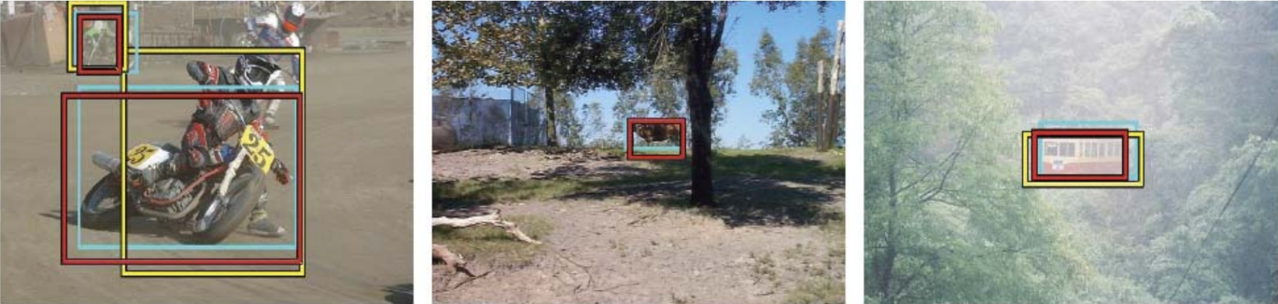
Related works
Objectness proposal generation methods
A small number (e.g. 1K) of category-independent proposals
Expected to cover all objects in an image
Measuring the objectness of image windows. PAMI 2012, Alexe, et al.
Selective Search for Object Recognition, IJCV 2013, Uijlings et al.
Category-Independent Object Proposals With Diverse Ranking, PAMI 2014, Endres et al.
Proposal Generation for Object Detection using Cascaded Ranking SVMs. CVPR 2011, Zhang et al.
Learning a Category Independent Object Detection Cascade. ICCV 2011, Rahtu et al.
Generating object segmentation proposals using global and local search, CVPR 2014, Rantalankila et al.
Notes:
为了改变这种情况，我们直观的想法是如果能够利用人是“物体”这种先验知识，先提取出含有物体的窗口，也就是先筛选出proposals，我们就能用一些稍微复杂的特征和分类器在这些候选窗口上过滤。

Slide 44
Object & Pedestrian Detection
Thank you for your attention!
Q&A

